Slide 1

The Agile methodology
Sarah C Jodrey
Southern New Hampshire University
CS-250 : Software Development Lifecycle
Professor Erin Tirrell
December 11, 2021

Slide 2

AGILE - WHAT IS IT?
Agile is a software development methodology designed to adapt and respond to change – especially in uncertain and turbulent environments (Agile Alliance, 2021b). This is done through continuous improvement with focus on short iterations.
Utilizing frameworks such as Scrum, Agile is guided by the 4 core values of The Agile Manifesto and is supported by The 12 Principles.
Individuals and interactions over processes and tools
Working software over comprehensive documentation
Customer collaboration over contract negotiation
Responding to change over following a plan
(Agile Alliance, 2021a)

Slide 3

THE SCRUM-AGILE TEAM
A Scrum-agile Team is comprised of a Product Owner, Scrum Master, and a Development Team.
The entire Scrum Team is accountable for creating a useful, and valuable, Increment at the end of a Sprint (Overeem, 2016).
Although everyone has a distinctive role, the Team works as one unit to achieve the Product Goal.
No hierarchy exists in a Scrum Team for they are self-managing and cross-functional (Overeem, 2016).

Slide 4

PRODUCT OWNER
The Product Owner is the one held accountable for the value of the product and for maximizing the output of the Development Team (Schwaber & Sutherland, 2020).
They work collaboratively with the users, stakeholders, and the Scrum Team to bring the perspective of the client to the forefront.
They are solely responsible for managing the Product Backlog – conveying, prioritizing, and updating the backlog items (Cobb, 2015).
Typically, there is only one Product Owner for a Scrum-agile project. However, for larger enterprise-level projects there may be more than one. In which case, they coordinate with Product Owners of similar efforts (Cobb, 2015).
They make the final decision to release a product or to continue development (James & Walter, 2021).

Slide 5

SCRUM MASTER
The Scrum Master is the one responsible for ensuring Scrum theory, practice, and rules are understood and adhered to by the Scrum Team (Cobb, 2015). This includes implementing the timebox for Sprint events.
They do not hold management authority over the Team.
The Teams wellbeing is a priority, and so, they facilitate as a coach, mentor, teacher, and conflict navigator (Overeem, 2016). They act as a gatekeeper, ensuring that those outside of the team understand which interactions are beneficial to the Team’s success.
They simultaneously lead their Team while serving the client and achieving results that are in line with the organizations objectives (Overeem, 2016).
Overall, the Scrum Master can understand a culture and implement the tactics that will increase the agility of all parties.

Slide 6

DEVELOPMENT TEAM
The Development Team consists of professionals that are dedicated to creating a usable Increment at the end of a Sprint (Schwaber & Sutherland, 2020).
They create and define the Increment of “Done” (Schwaber & Sutherland, 2020).
Every member is a Developer – no titles.
They are self-organizing and cross-functional with leadership occurring organically within the team (James & Walter, 2021).
They work with the Product Owner to plan one Sprint at a time and refine the product backlog as a team (Overeem, 2016).

Slide 7
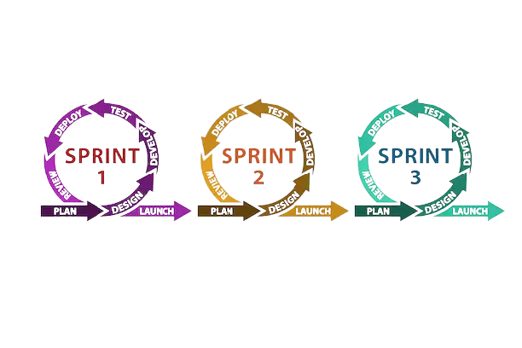
AGILE SOFTWARE DEVELOPMENT LIFE CYCLE
The Agile software development life cycle is done in short iterations following the pattern of plan, design, develop, test, deploy, review, and launch (Cobb, 2015). This is implemented in the Scrum-agile framework via the Sprint, Sprint Planning, Daily Scrum, Sprint Review and Sprint Retrospective events and the Product Backlog, Sprint Backlog and Increment artifacts (James & Walter, 2021).
(Blake, 2021)

Slide 8

AGILE SOFTWARE DEVELOPMENT LIFE CYCLE CONT.
THE SPRINT – is the heart of Scrum and acts as a container for all other events and artifacts essential to the Product Goal (Schwaber & Sutherland, 2020).
SPRINT PLANNING – is a very important event as it lays the groundwork for the entire Sprint. It is led by the Product Owner who collaborates with the Team to declare a goal for the Sprint. They then determine which items from the Product Backlog will be included in the Sprint with the Developers creating an Increment that meets the Definition of Done for each item (Schwaber & Sutherland, 2020).
DAILY SCRUM – is a 15-minute event for the members of the Development Team to discuss and reflect on their progress toward the Sprint Goal. This daily event is important to improving communication, sharing impediments, and adapting the Sprint Backlog if necessary (Schwaber & Sutherland, 2020).
SPRINT REVIEW – provides the Team with a chance to present their work to key stakeholders and discuss their progress toward the Product Goal. It is an important collaborative event as any new prospects can be added to the Product Backlog.

Slide 9

AGILE SOFTWARE DEVELOPMENT LIFE CYCLE CONT.
SPRINT RETROSPECTIVE – is a time for the Scrum Team to reflect on the last Sprint and discuss any areas that could use improvement or areas in which they excelled. This can be regarding individuals, interactions, processes, tools, or their Definition of Done (Schwaber & Sutherland, 2020). It is the final stage of the Sprint.

Slide 10

WATERFALL OR AGILE – HOW TO CHOOSE
AGILE is incremental and iterative (Cobb, 2015). It is a good fit when:
• You prefer a flexible and adaptable approach to meet changing needs.
• The project has some uncertainties, needs to make it to market quickly, or is a larger scale.
• You want to encourage creativity, opportunity, and learning.
• You want the product to focus on customer satisfaction and emphasize collaboration and interaction.

Slide 11
WATERFALL OR AGILE – HOW TO CHOOSE CONT.
WATERFALL is sequential and linear (Cobb, 2015). It is a good fit when:
• The project is well-defined, and the requirements are clear and static – dates of completion, thoroughly documented product requirements are approved by stakeholders.
• You want the developers and testers to focus on their work rather than interact with the stakeholders or clients.
• You prefer a strongly plan-driven approach.

Slide 12
References
Agile Alliance. (2021a, August 10). Agile Manifesto for Software Development | Agile Alliance. Agile Alliance |. https://www.agilealliance.org/agile101/the-agile-manifesto/
Agile Alliance. (2021b, December 2). What is Agile Software Development? Agile Alliance |. https://www.agilealliance.org/agile101/
Blake, S. (2021, February 11). Agile Software Development Life Cycle [Diagram]. Easy Agile. https://www.easyagile.com/blog/agile-software-development-life-cycle/
Cobb, C. G. (2015). The Project Manager’s Guide to Mastering Agile: Principles and Practices for an Adaptive Approach (1st ed.). Wiley.

Slide 13
James, M., & Walter, L. (2014, April 3). Scrum Reference Card | Scrum Reference Card. Scrum Reference Card. https://scrumreferencecard.com/scrum-reference-card/
Overeem, B. (2016, July). Characteristics of a Great Scrum Team. Scrum.Org. https://www.scrum.org/resources/characteristics-great-scrum-team-0
Schwaber, K., & Sutherland, J. (2020, November). The Scrum Guide. Scrum.Org. https://www.scrum.org/resources/scrum-guide

